Slide 1
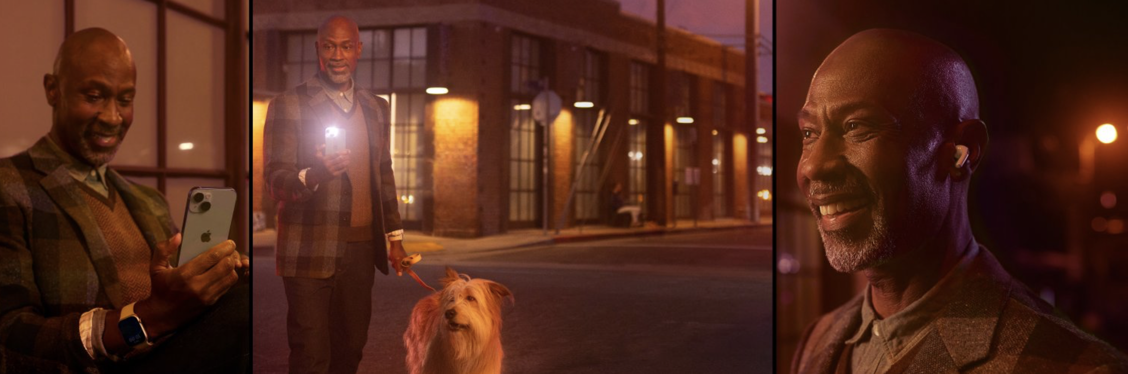
#AppleSupport
Sentiment Analysis and Modelling from Twitter
- Kamini Nayyar

Slide 2
Customers are the backbone of any Business.
Goal is to help organizations determine how Customers feel about their businesses.

Slide 3







#ToolStack
Dataset 3M rows from 2017-19.

Slide 4
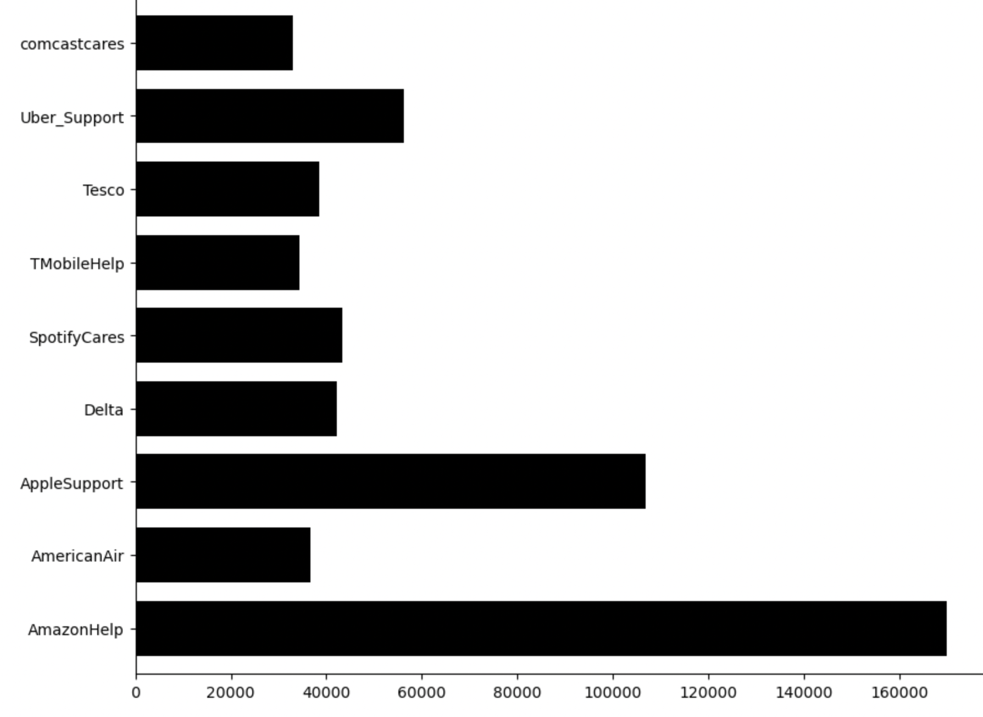
Top 10 Support interactions by brands
#LoveAppleProducts
Over 100k tweets

Slide 5
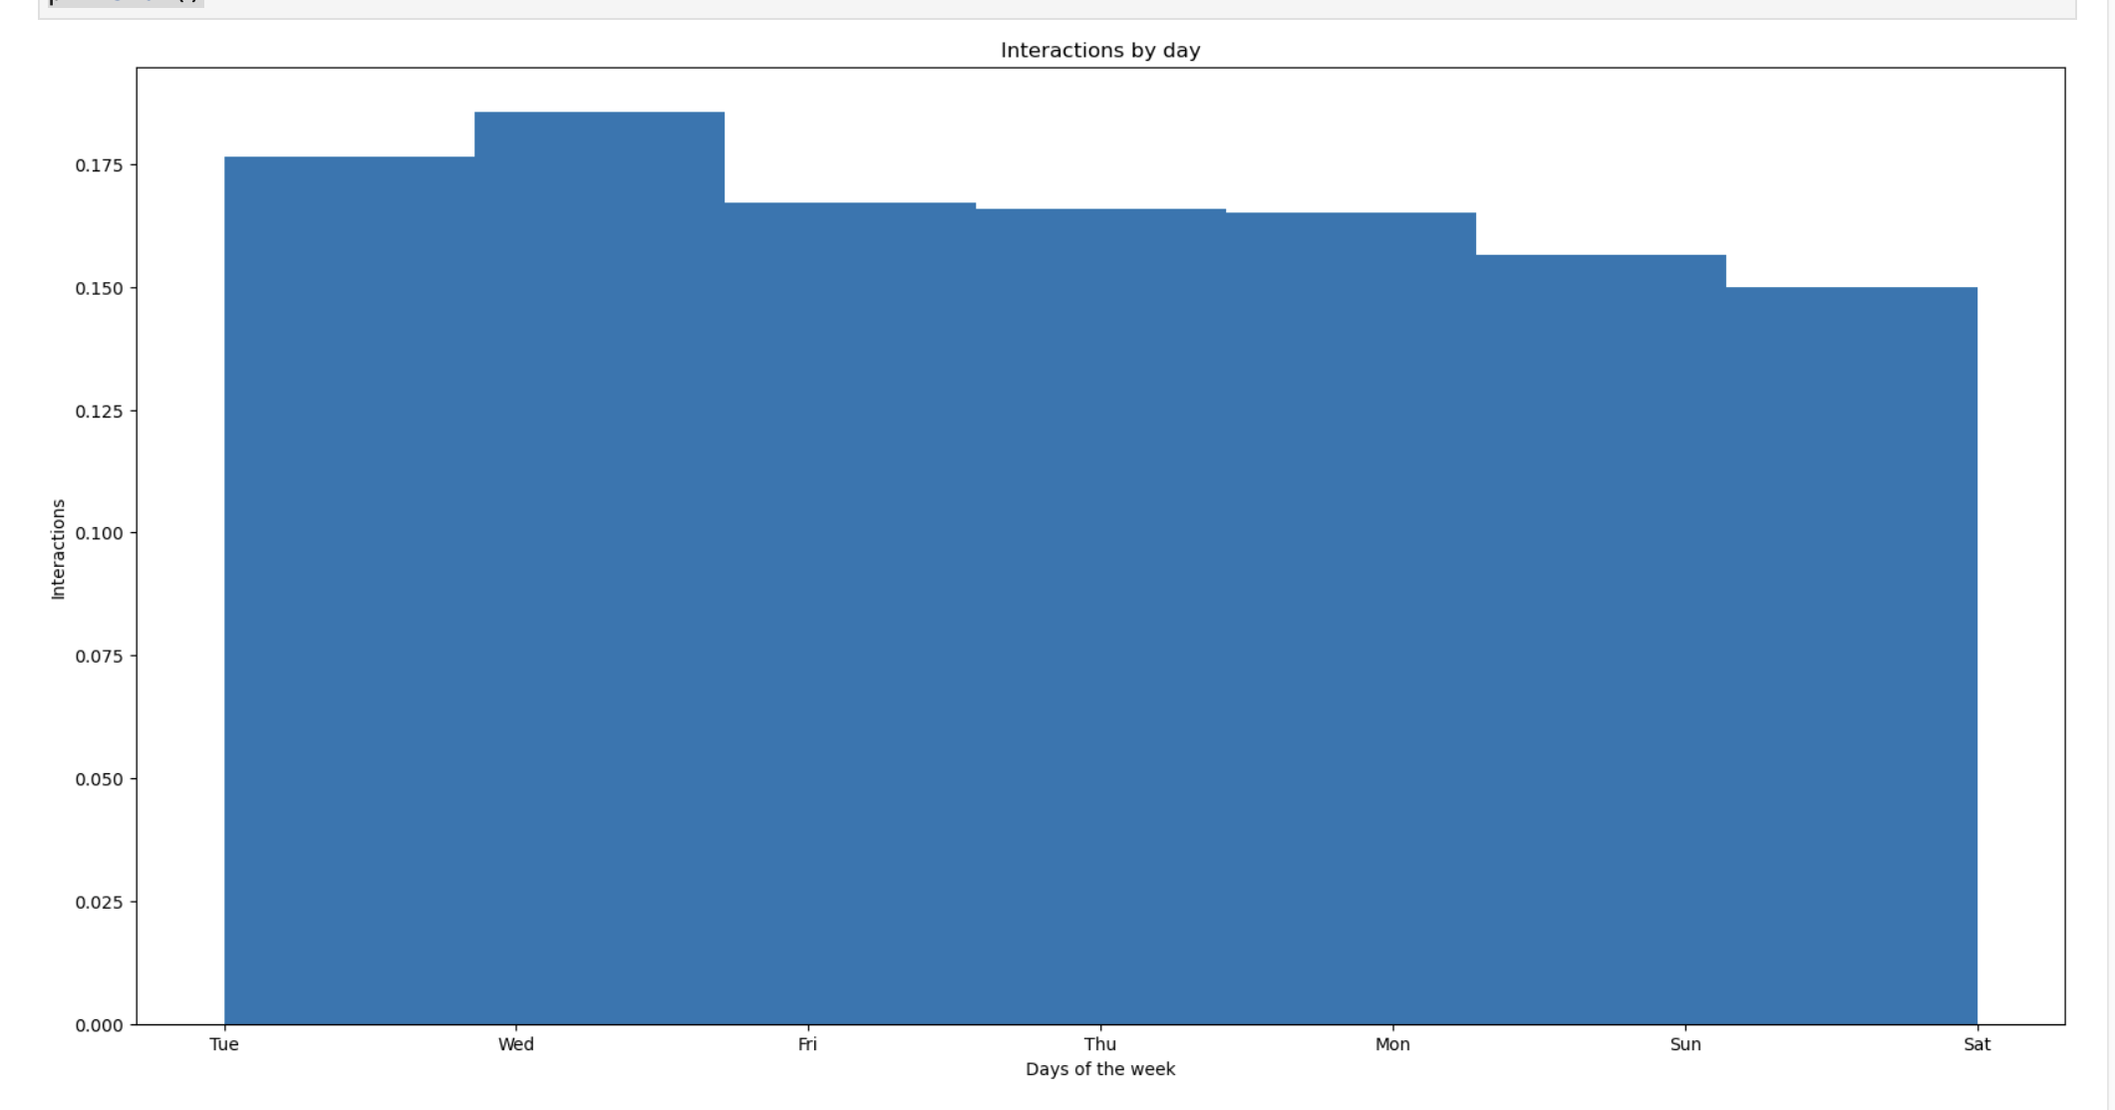
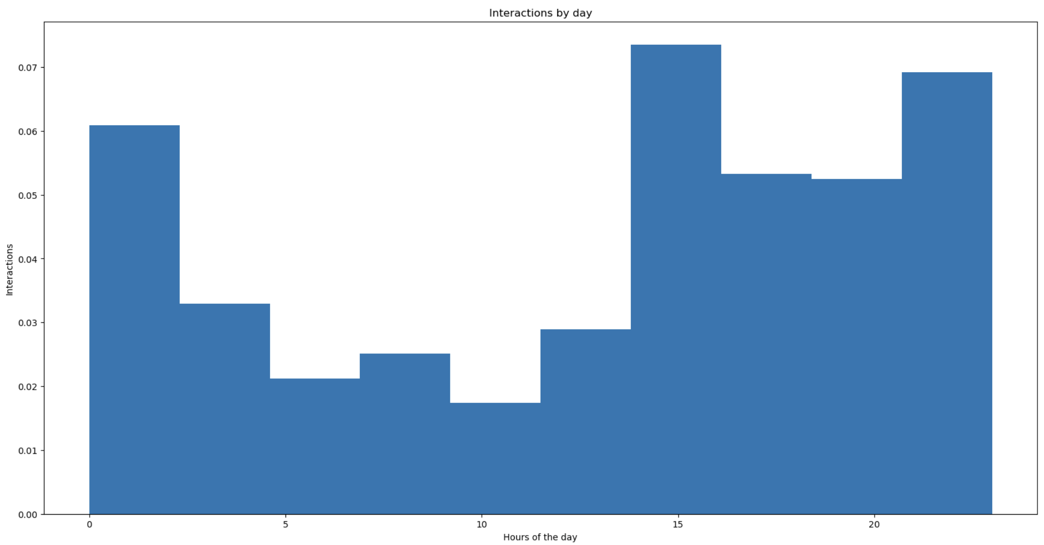
Exploring #AppleSupport Data
Interactions per day
Interactions per hour
Interactions
Tue
Wed
Fri
Thu
Mon
Sun
Sat
0
5
10
15
20

Slide 6
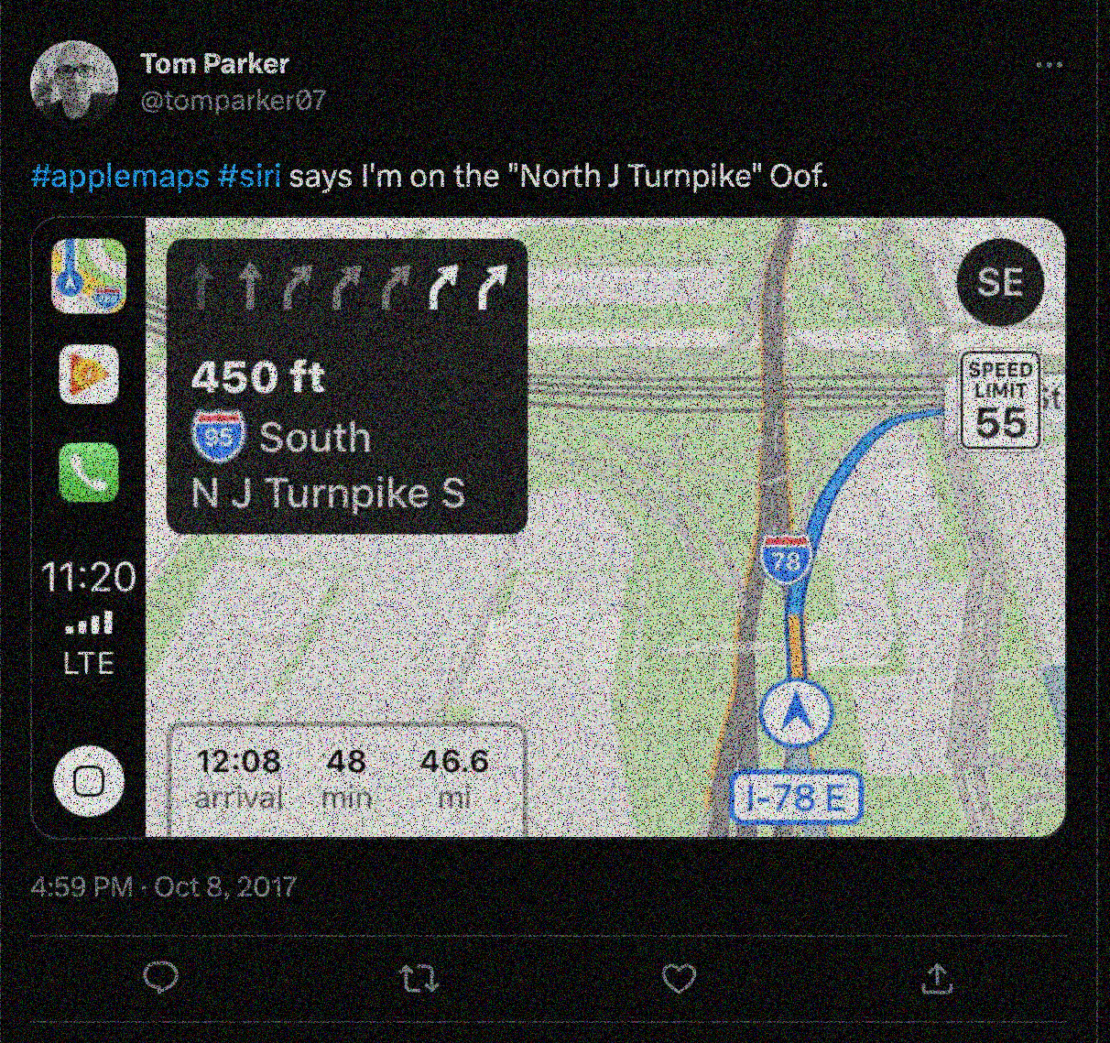
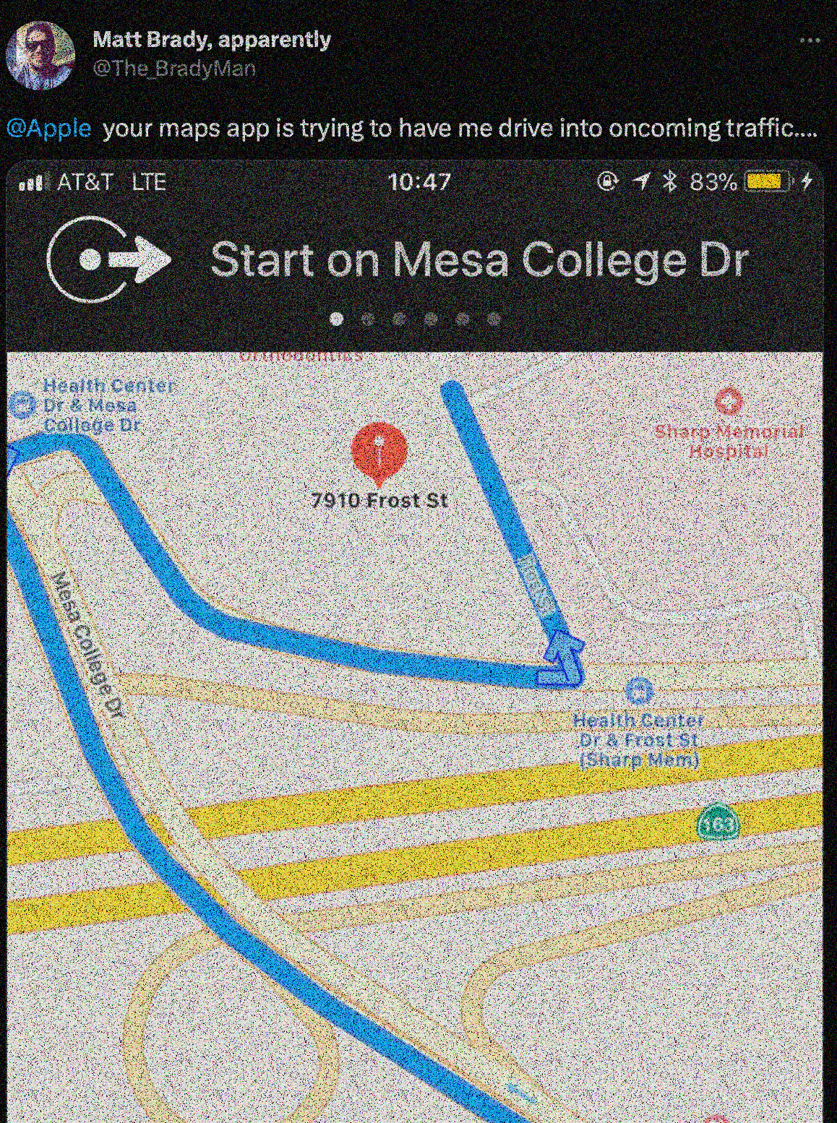
@Apple your maps app is trying to have me drive in the incoming traffic..
@keyPoints
1) Avg. time to tweet back:
2 hours and 27 minutes
2) Max. time to tweet back:
32 Days and 20 hours
#applemaps #siri says I’m on the “North J Turnpike”

Slide 7
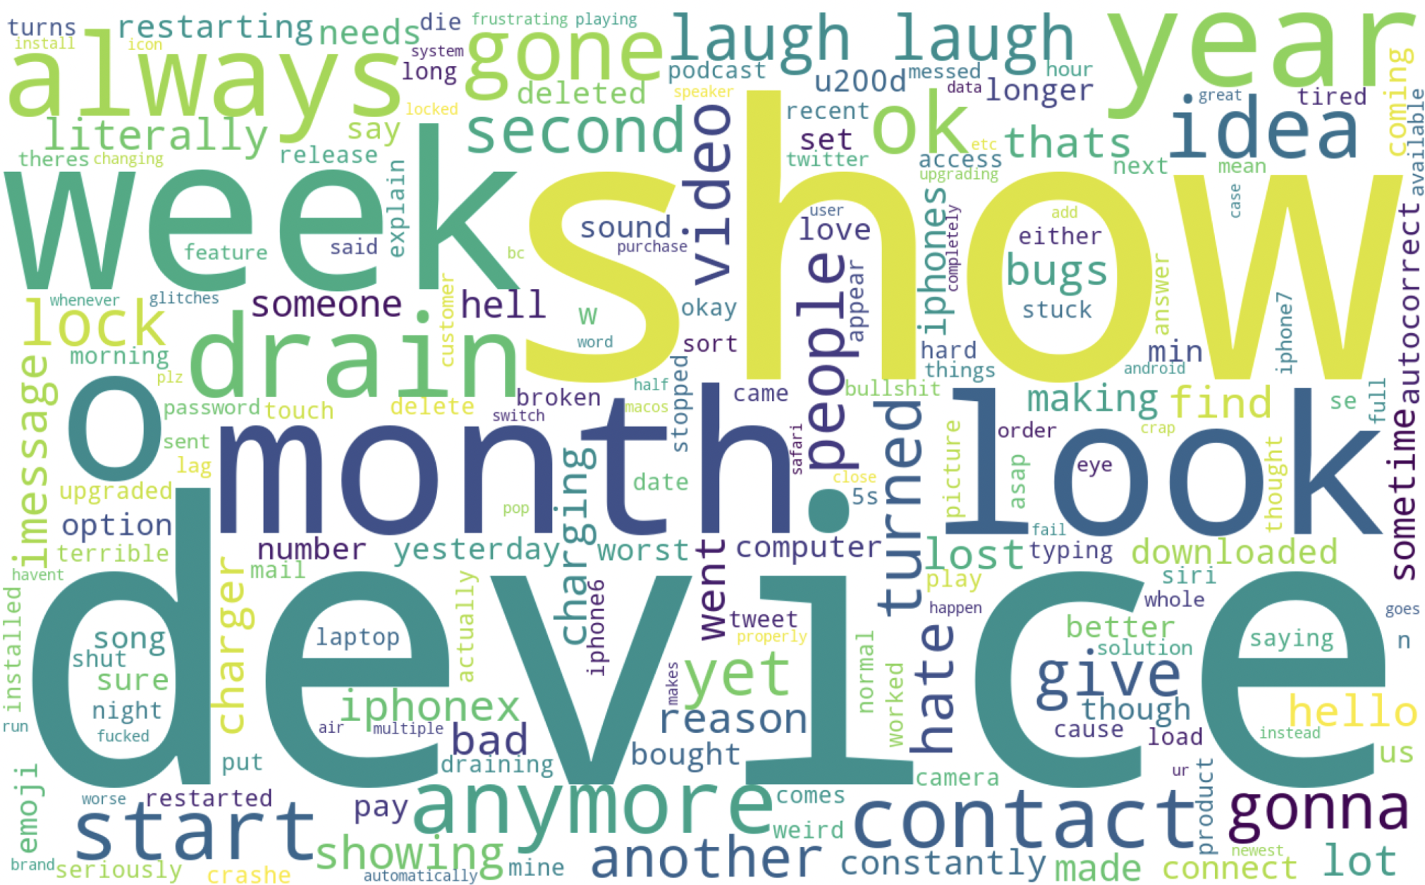
CRY FOR HELP…..
Most frequent words used from 2017-2019

Slide 8
#SentimentAnalysis

Slide 9
@AppleSupport
-0.521
#BarelyRunning
0.643
Positive vs Negative
#UpgradeTomorrow

Slide 10
#Modeling

Slide 11
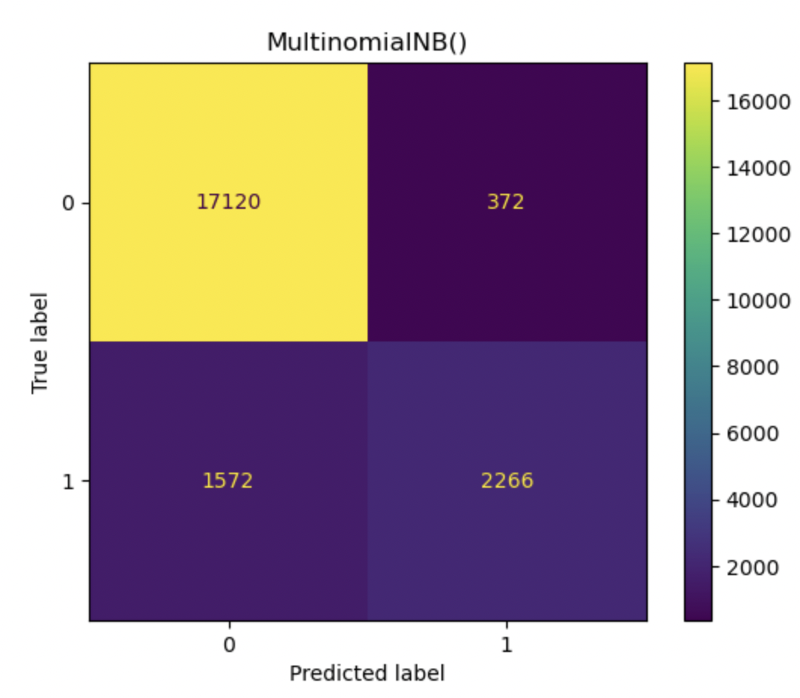
@ConfusionMatrix
This model performed the best
giving an accuracy of 90.89%.
Notes:
372 false Positive.(model predicted negative but they are actually positive)
And1572 false negative (actually negative reviews but model predicted positive)

Slide 12
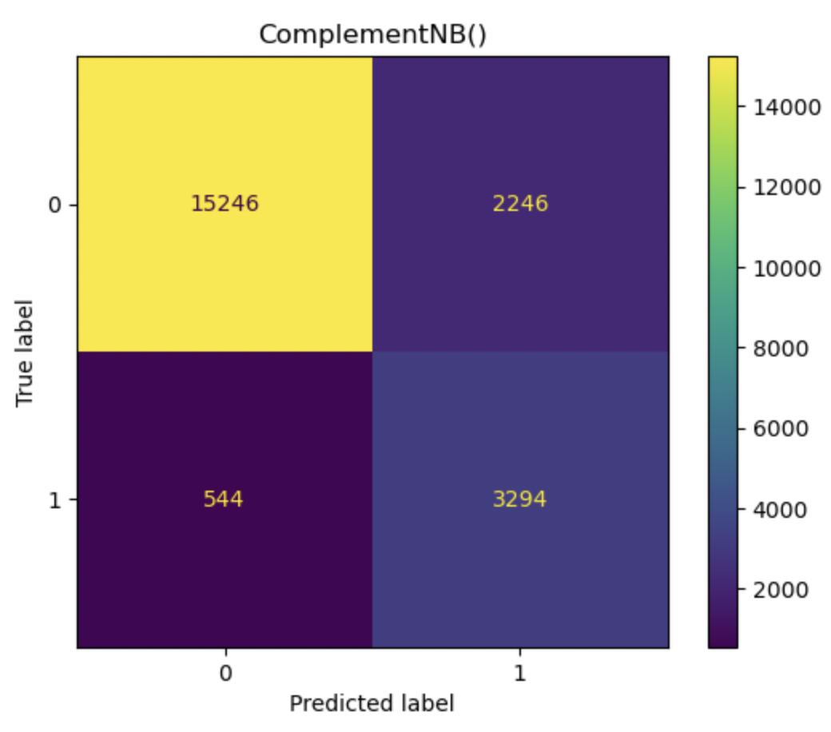
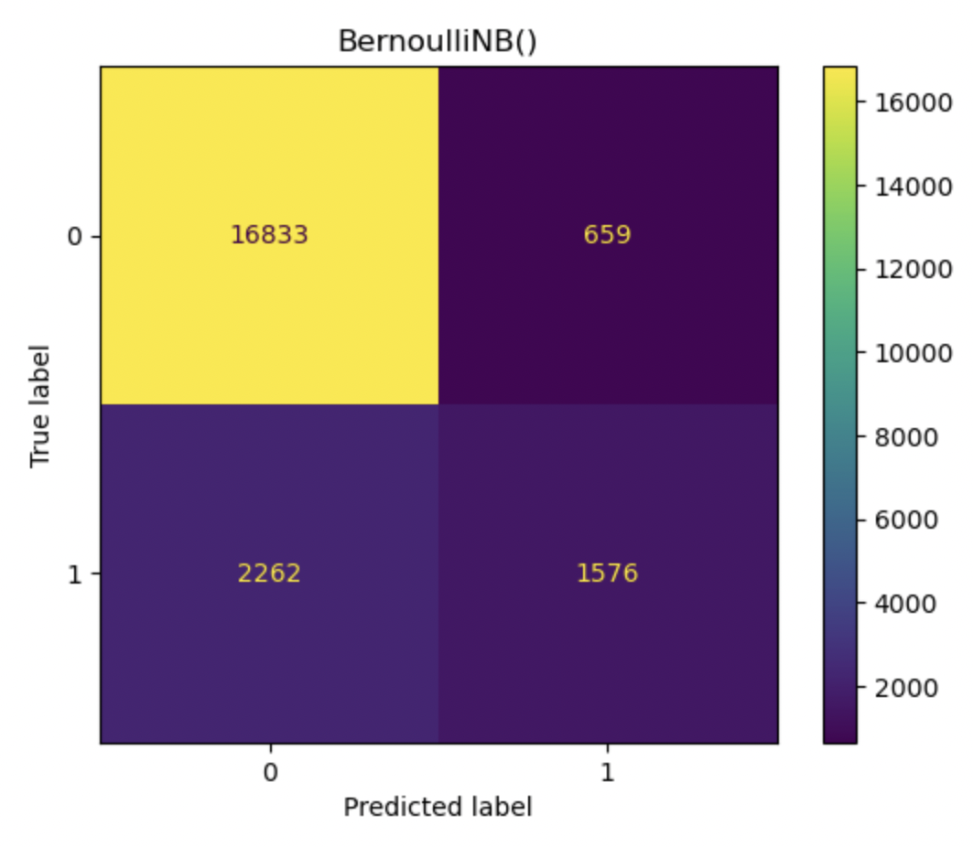
Appendix
1)
Other Models:
2)
Ngrams for Multinomial:
Bigram gave 79.34% accuracy where as
Trigram performed at 76.61%
Used Bayes' theorem because it works well for the Classification problems. I tested my model with Complement Naive bayes, Multinomial & Bernoulli’s.
3)
TF-IDF worked slightly better for Complement bringing it to 87.11%
4)
Github link:
https://github.com/KaminiNayyar/Client_Sentiment_Analysis
Accuracy:- 86.92%
Accuracy:- 86.31%
Notes:
372 false Positive.
and

Slide 13
#FutureProject Time series analysis for bank’s iTrade department.

Slide 14
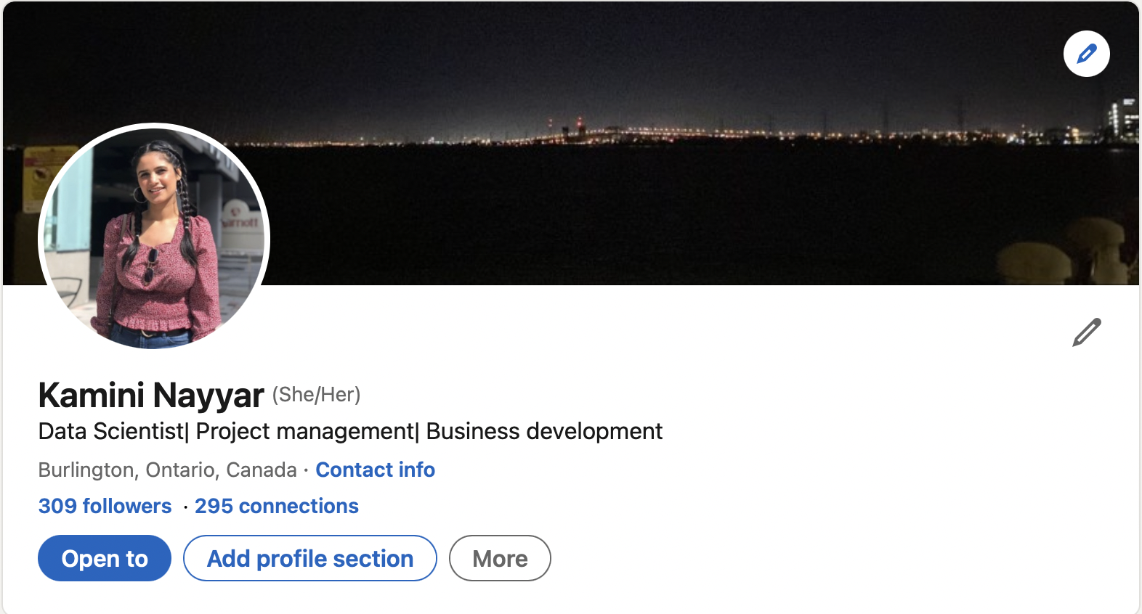
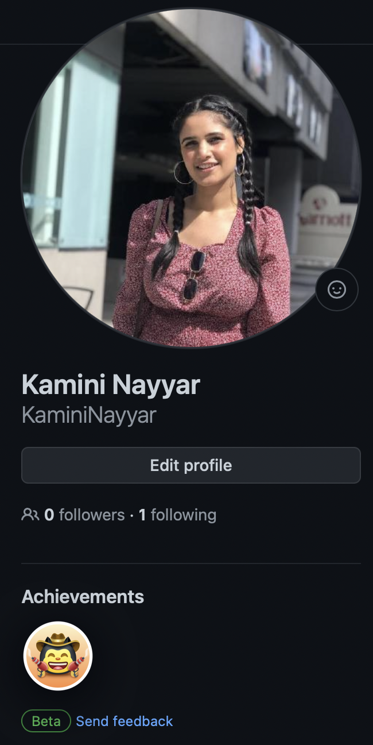
Thank you!!

